Slide 1

Promoting
IAGenWeb
Encouraging visitors and volunteerism
Cindy Booth Maher
Welcome Hostess
&
County Coordinator for
Cherokee, Johnson & Linn Counties
Notes:
Use this slide to set up the projector and leave it on while people gather.
You can do an introduction and when you are ready click to go to the next slide.

Slide 2
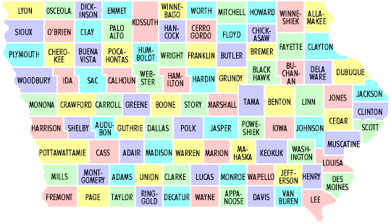
14 Orphan Counties
Notes:
Since we’ve been talking about the special projects, we need to emphasize that even though the special projects are helpful, the county site is the heart of the whole project.
Talk through this slide as each heart appears.
Something you might want to say is:
As of January 12th there were:
77 volunteers who serve as County Coordinators and
13 volunteers who serve as Assistant County Coordinators
Our volunteers spend any where from 1 to 10 hours per week (or more) on their county site.

Slide 3
Thanks to our Orphan Care Givers
Adams County | Carroll County | Emmett County | Greene County | Ida County
Kathy Paramenter | Rich Lowe | Conni McDaniel Hall | Conni McDaniel Hall | Mary Alice Schwanke
Jackson County | Jones County | Lee County | Lyon County | Mahaska County
Rich Lowe | Conni McDaniel Hall & Steve Williams | Conni McDaniel Hall | Cindy Booth Maher | Cindy Booth Maher
Pottawattamie County | Poweshiek County | Sac County | Scott County
Conni McDaniel Hall | Sara Thorson Little | Paul Nagy | Lynn McCleary

Slide 4

Drumming Up Volunteer Interest
Email
Facebook
Genealogical Societies
Personal Visits & Meeting Presentations
Brochures
Newsletter articles & ads
Gen Society Facebook

Slide 5
Society – GenWeb Cooperation
Gen societies may feel threatened by on line resources.
Cooperation is the best way to help people research their families.
Funds can be raised locally by offering society local research services on line.
Transcribed indexes can drive society business.
County Coordinator can refer queries to local genealogical society. A “win-win” situation!

Slide 6
Volunteers
Ways to Contribute
Transcribe records
Post info to Boards
Iowa Gravestone Photo Project
Look ups
Adopt a county
  Requirements?
  Recruitment pool?

Slide 7
Promotion Presentation

Slide 8
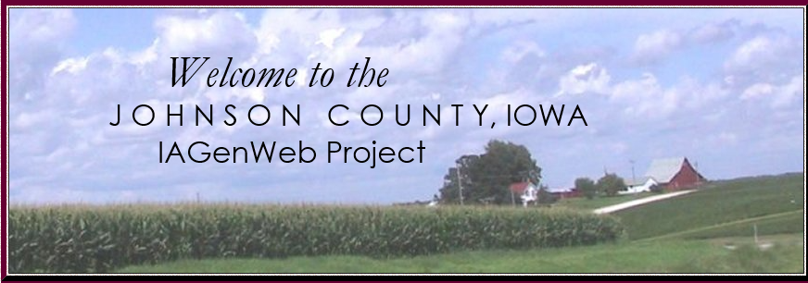
Cindy Booth Maher
County Coordinator & Web Master

Slide 9


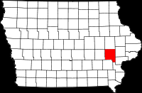
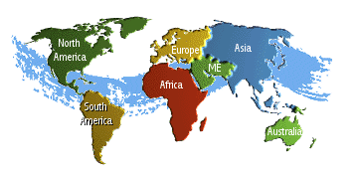
Part of a Bigger Picture
Johnson
An all volunteer project committed to
free Internet access to genealogical information
Notes:
The graphics will automatically go from graphic to graphic. You can just mention each part of the project but I wouldn’t go into detail.
Or you can just say the following and then go back and mention each part of the project by name:
IAGenWeb is part of the USGenWeb Project, a group of volunteers working together to provide Internet websites for genealogical research in every county and every state of the United States. The Project is non-commercial and fully committed to free access for everyone.

Slide 10
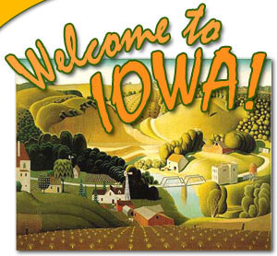
IAGenWeb
Notes:
Use this slide to set up the projector and leave it on while people gather.
You can do an introduction and when you are ready click to go to the next slide.

Slide 11
IAGenWeb
Ninety-nine County Sites
Notes:
Iowa is one of the best in the Country because when IAGenWeb organized in 1977, our leadership set up some basic requirements.
These requirements:
A search engine for the site.
The addition of random data at least every 6 months. Such things as obituaries, births, deaths, etc. that are not complete.
The addition of transcribed data at least every year. A complete set of data such as all obits from the 1910 Newspaper or all births in 1890 or all marriages in 1900.
Communication with visitors to the sie.

Slide 12

Family Tree Magazine awarded IAGenWeb Best Iowa State genealogy website six years in a row!
What they said: “One of the most useful state websites in the USGenWeb Project , this Hawkeye State site has more than a million gravestone photos, more than 2,900 family group sheets, state census transcriptions from 1836 to 1925 and more. Under Quick Links, select either a county or a special project.”

Slide 13
Our Name
Gen = Genealogy
Web = Web site
US = United States
IA = Iowa
IAGenWeb = Iowa Genealogy on the Web
Can always tell a FREE GenWeb site
NEGenWeb
SDGenWeb
MNGenWeb
Notes:
I’ve found that people don’t understand the name and have a hard time remembering it. So I’ve come up with this explanation.
Just go through each one and then have them tell you the other two state. You could add others if you want.
If you don’t want to use this slide, delete it.

Slide 14
County Coordinator
The title of the person responsible for a county page.
Duties vary from state to state.
Some states don’t have much information.
Iowa has “requirements” that results in a richer source of information.
Twice-yearly reviews.
Notes:
Each point will automatically appear after 1.5 seconds. This seems like a long time when you’re just watching the slide show, but not very long when you are talking. Don’t read the items to the audience – THEY CAN READ!
You talk about your own experience or use your own words to tell the audience what you want. I wouldn’t go into a lot of detail here, though. You will do that as you go through each component of the site – ie: when showing the GPP site, talk about the CC’s responsibility in approving all of the photos, etc.

Slide 15
GenWeb Special Features
Iowa Genealogy Boards
Iowa Special Projects
USGenWeb Special Projects
Notes:
This is just an introductory slide. Just talk these words and the topics will appear automatically. You can get a better hang of it if you practice a little before your presentation.

Slide 16






IAGenWeb Boards
Researchers can enter their own data
Notes:
This page is set up so that you have to click to see the next graphic so you can talk about it.
The graphics are set up as hyperlinks so you can click on the graphic and go to that page.
These are set up for Plymouth county. If you want to show some of the other counties that will be there, change the hyperlink.
To change the hyperlink
Click on View > Normal
Right click on the graphic
Select > Edit Hyperlink – then copy and past the correct hyperlink in the box. The old link will be replaced by the new link.
Spend as much or time here as you need and talk about your role as CC for each feature.
These sites are also shown later as part of the section on How to Contribute.

Slide 17







IAGenWeb Special Projects
Notes:
You have to click to go from graphic to graphic because you will either talk about each one OR IF you have an Internet connection go directly to that SP site
If you have to speak about each project without the help of the Internet connection, you might want to print out the special projects page at http://iagenweb.org/state/archives.php so you have the information.
You can spend as much time here as you want and talk about your role as the CC AND this is actually a good place to talk about what they can do as a volunteer.

Slide 18
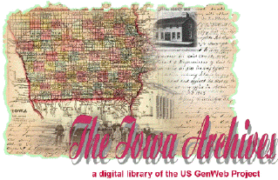




USGenWeb Special Projects
Iowa Related
National
And More
Notes:
All of the graphics below the title have hot links to the Internet site.
Archives: The USGenWeb Digital Library for Iowa was developed to provide free on line data for genealogical research.
The Archives was set up before a lot of the counties had on-line data. In Iowa most, not all, of the data is on the county sites. But in other states this is the place to look.
As with all other information found on GenWeb sites, these archives are dependent on volunteers to donate their time by transcribing public domain records or other non-copyrighted primary sources.
Tombstone Project: Again this was set up before many of the county sites put cemetery lists on their sites. Today most counties have extensive cemetery listings on the county sites. But you can always check here for information, especially in other states.
Other USGenWeb Projects:
I selected the Family Group Sheets, the kids site and penny postcards as a variety

Slide 19
County Site is Heart of Project
Notes:
Since we’ve been talking about the special projects, we need to emphasize that even though the special projects are helpful, the county site is the heart of the whole project.
Talk through this slide as each heart appears.
Something you might want to say is:
As of January 12th there were:
77 volunteers who serve as County Coordinators and
13 volunteers who serve as Assistant County Coordinators
Our volunteers spend any where from 1 to 10 hours per week (or more) on their county site.

Slide 20
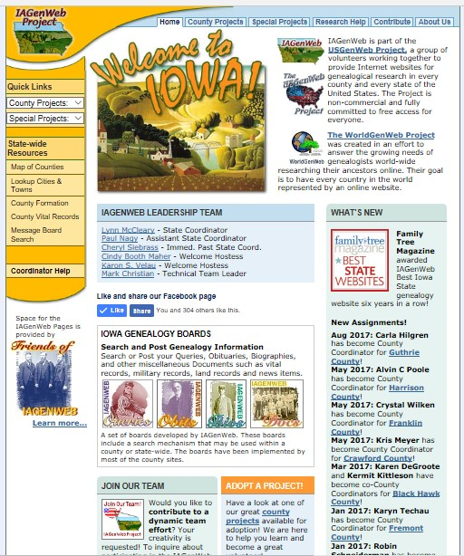
IaGenWeb

Slide 21
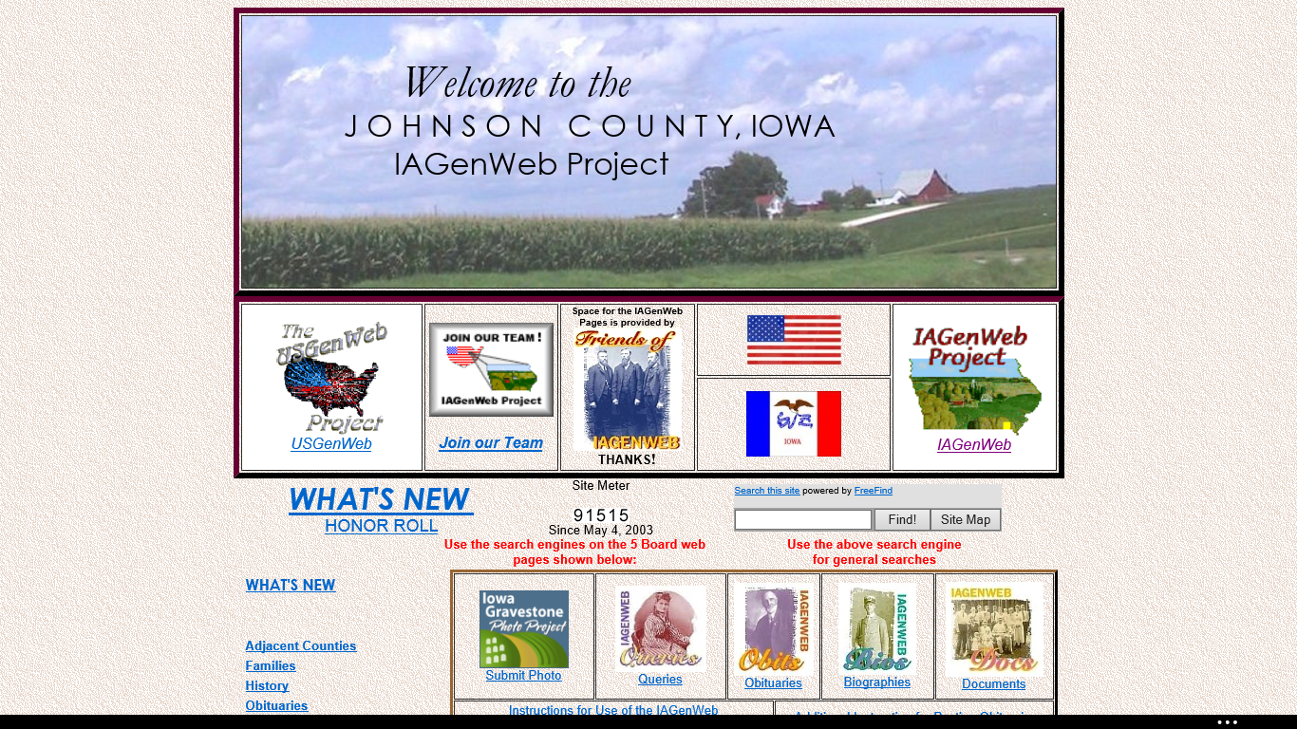

Slide 22
How Can You Participate?
Contribute material to the boards – searchable state wide.
Contribute material to the GPP – searchable state wide.
Join our Team
Transcribe historical materials or vital records.
Become a County Coordinator or an assistant
Notes:
Talk about ways that volunteers can assist. Change or add any point here that you want. Perhaps there is a special project you are working on that you want to advertise.
IF you are hooked into the Internet, he first two bullets have a link to a page that will show what that item looks like. Go there and show how easy it is to post. Also go to the Join Our Team web site.
If you are not hooked into the Internet, use the following slides to explain the boards and GPP.

Slide 23
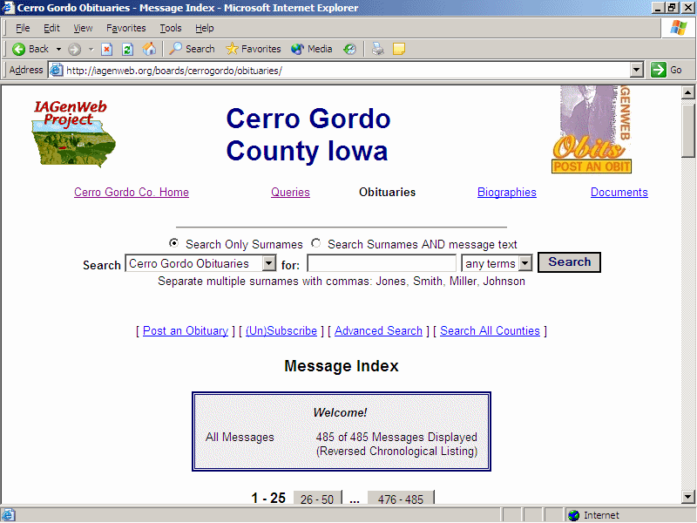
Contribute to the Boards
Search for a name
To Post
Notes:
Show the various parts to this screen. The fact that you can enter Queries, Obituaries, Biographies and Documents – news items, wills, etc.
You can point out that this site has 485 obituaries on site.
To activate the “Search for a name” text box, click on the screen.
Explain that you can also do a state wide search.
The “To Post” text box will automatically appear 3 seconds later.

Slide 24
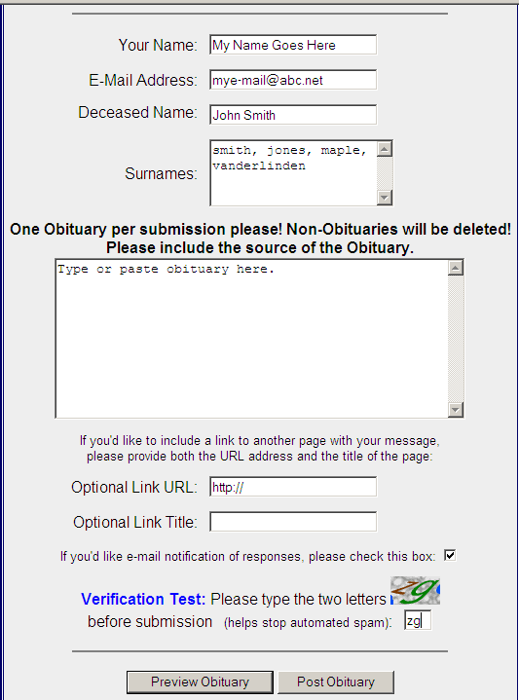
Add a link to a biography, photo, etc.
This feature is to prevent spam on the boards.
Click to post or preview
Notes:
Use the slide to show people how easy it is to submit an obituary.
Suggest they leave a space between paragraphs so it the obit is easier to read.
To active the first text box “Add a link etc.” click on the screen. After that the other two text boxes will appear automatically 3 seconds apart.
Don’t worry if the other text boxes appear before you are done talking about the one before it.

Slide 25
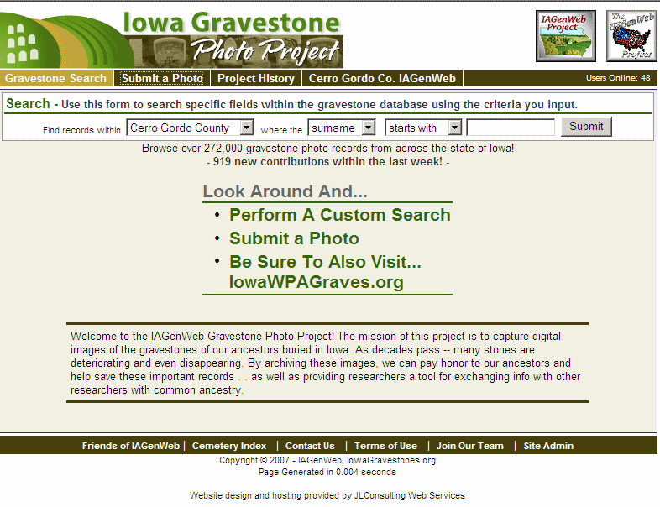
Contribute to the Gravestone Photo Project
Notes:
Iowa Gravestone Photo Project History
The "Gravestone Photo Project" or "GPP" was first undertaken as a single county gravestone photo archive. Originating as an IAGenWeb Special Project in January 2003, it has grown to include separate repositories in over a dozen states -- and is now believed to be the largest gravestone photo repository in the world.
To learn more about the history of GPP click on the Project History on the real site at http://iowagravestones.org/

Slide 26
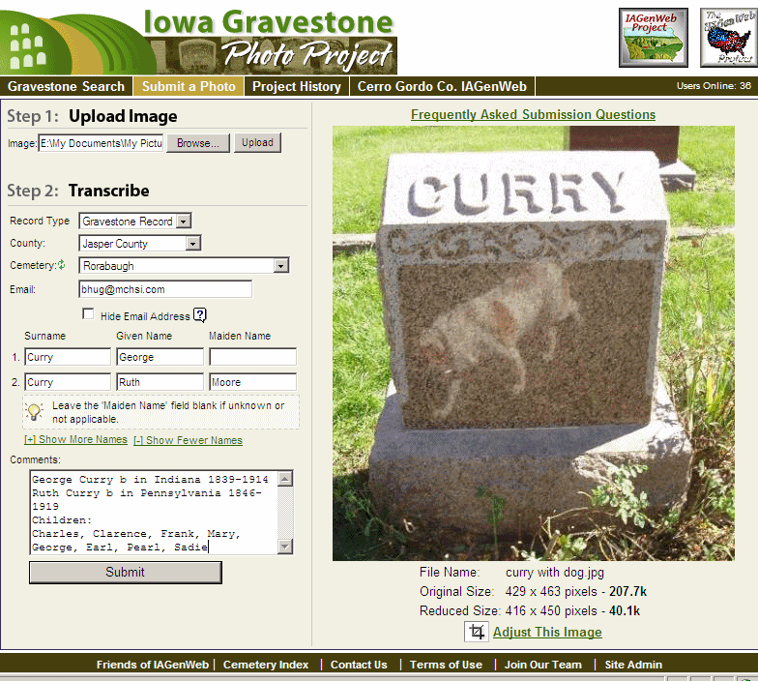
Submit Gravestone Photos
Notes:
This is the submit photo page.
Point out that this is a POOR photo to submit because the image of the dog walking around in the cemetery shows up in the tombstone. Peoples feet and bodies and shadows often show up on photos like this. SO be careful when taking the photo.
Tell people to add information in the Comment section as it make the photo more valuable to researchers.

Slide 27
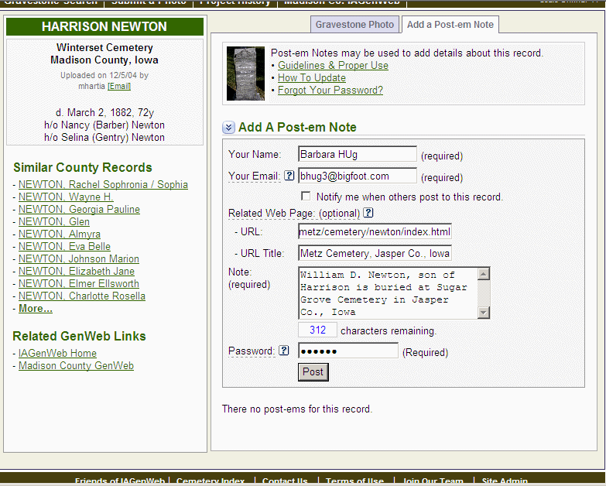
Add Post-em Notes to Photos
Notes:
Us this slide to show how to add a post-em note to an existing gravestone photo. This is a new feature of the Gravestone Photo Project.

Slide 28
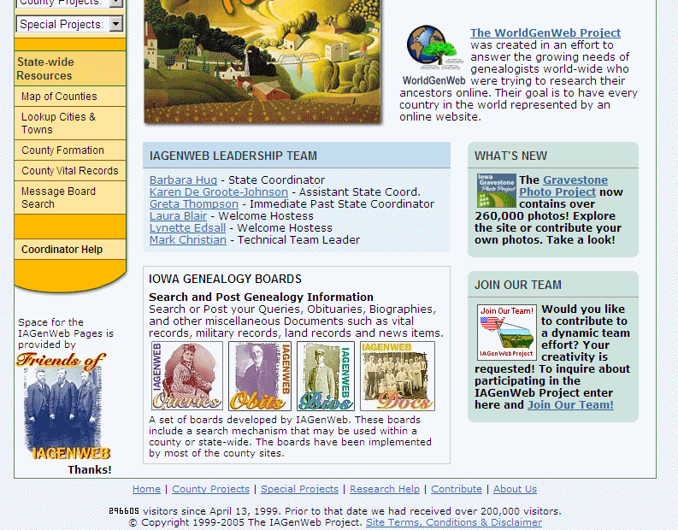
Join Our Team
Notes:
This is the main IAGenWeb page. Show how to access the Join Our Team page.
The circle will automatically appear.

Slide 29
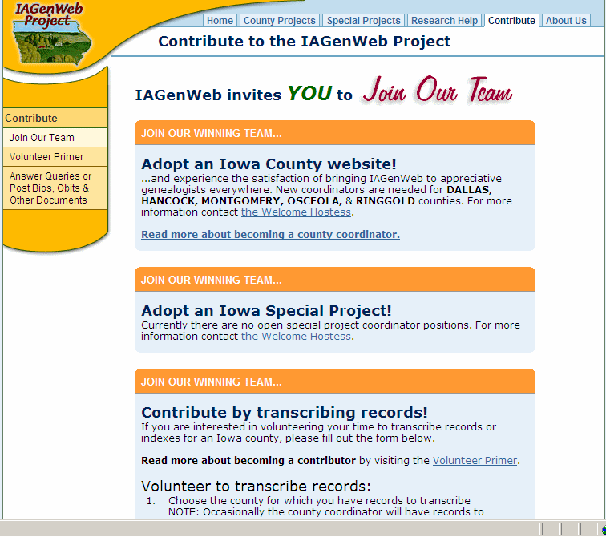
Notes:
Shows the ways to contribute.

Slide 30
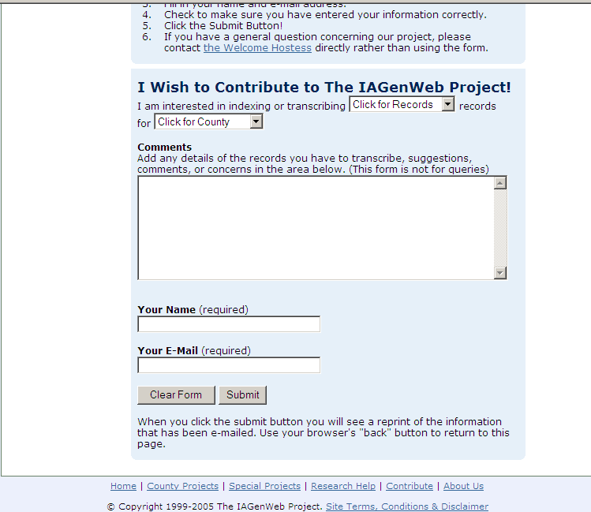
Complete the Form to Volunteer
Notes:
This is the on-line form used to volunteer to be a part of IAGenWeb.

Slide 31
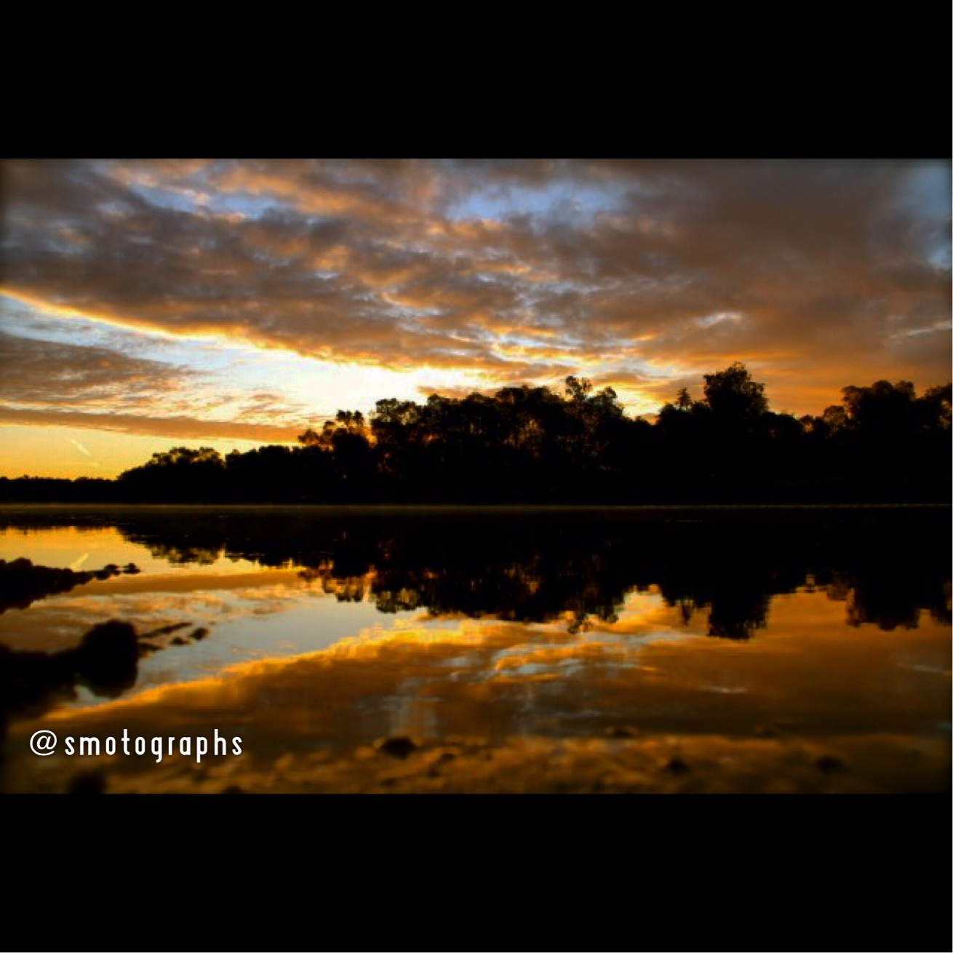
Iowa Sunset
Photo by Sean Maher

